Slide 1



Forest Fire Detection Using Deep learning
Name : Paartha K
Aicte Student ID: STU67d05c24db81e1741708324
Aicte Internship ID:INTERNSHIP_174099535967c57b1f336c3

Slide 2

Learning Objectives
Understood the use of CNN for this project
How Convolutional Neural Networks (CNNs) are used to detect forest fires from images.
Know how conv 2d works
Exploring and building the model for two classes which are fire and no-fire
Analyse the accuracy of the model
Interpreted results using metrics like accuracy and confusion matrix to understand model effectiveness.
Applied training techniques and split data to evaluate how well the model detects fires and no-fire.
Learned the end-to-end process of building a CNN model for a real-world application.
Worked on creating a deep learning model to classify images into two categories: Fire and No Fire.
GOAL
Source :
www.freepik.com/

Slide 3
No need to install anything locally — everything runs in the browser.
Tools and Technology used
Google Colab – Used as the coding platform with free GPU support Which is T4.
Python – Programming language used to build the project.
Frameworks Used – Tensorflow,Keras,Kaggle Api
Model Used - Convolutional Neural Network (CNN), Conv2D, MaxPooling2D, Flatten
Development Environment - Google Colab was used as the main development environment,
It provides a cloud-based Jupyter notebook setup with free access to GPUs(T4), which helps speed up model training. No need to install anything locally everything runs in the browser.
Matplotlib – Used to plot accuracy and loss graphs for model performance.
TensorFlow & Keras – Used to create and train the deep learning (CNN) model.
Dataset Used – Dataset is taken from the Kaggle website which is freely available ,
Link for the dataset=https://www.kaggle.com/datasets/elmadafri/the-wildfire-dataset

Slide 4
Methodology
Getting the Dataset We started by downloading a wildfire image dataset from Kaggle using a tool called Kaggale The dataset was neatly organized into folders for training, validation, and testing, with images categorized as either "fire" or "no fire".
Setting Up the Environment Since training deep learning models can be slow on regular CPUs, we checked whether a GPU was available and enabled it to speed up the training process. This setup was done in Google Colab Where everything is Free and we ran the code in T4 CPU configuration
Understanding the Data Before jumping into model building, we explored the dataset. We checked how many classes there were (fire vs. no fire), and previewed a few sample images from each class. This helped us understand the kind of data the model would be working with
Preparing the Images
We used Keras ImageDataGenerator to load and prepare The images .this tool also helped us scale
the pixel values and apply some basic image transformations (like flipping or zooming), which makes
the model easier for different class conditions

Slide 5
Methodology
Building the Model A Convolutional Neural Network (CNN) was built using TensorFlow and Keras. This model includes several layers like Dense layers to make the final classification between fire and no fire. Dropout was also added to prevent overfitting ,
Training the Model The CNN was trained using the training data. While training, we kept an eye on the model’s performance on the validation set to ensure it was learning correctly and not just memorizing the training data
Evaluating the Model After training, the model’s accuracy was tested using a separate test set (images it hadn’t seen before). This helped us measure how well the model could generalize to new, unseen data
Making Predictions Finally, we used the trained model to predict whether new images contained fire or not. We also visualized some results to see how well the model was doing in real-world scenarios.

Slide 6
Problem Statement:
Causes of Forest fire :
Rapid Spread,Environmental Destruction, Human and Economic Loss, Limitations of Traditional Methods, Need for Intelligent Solutions,Consumption of real word Time
Forest fires are becoming more frequent and intense due to climate change and human activities. They can destroy thousands of acres of land, harm wildlife, pollute the air, and put nearby communities in danger. The biggest challenge is spotting fires early—before they grow out of control. Traditional methods like satellite images or manual watchtowers often detect fires too late, especially in remote or dense forest areas.
Solution:
To solve this, we need a smarter, faster, and more reliable way to detect fires as soon as they start. Deep learning—a type of artificial intelligence that mimics the way our brain learns—offers a powerful solution. By training deep learning models on thousands of images showing both fire and non-fire scenes, we can build systems that “see” and recognize signs of fire instantly.
These models, especially Convolutional Neural Networks (CNNs), can detect fire from camera feeds, drone footage, or even satellite images in real time with high accuracy. This means faster alerts, quicker responses from firefighters, and less damage to nature and human life.
With the help of deep learning, we can move from reactive to proactive—creating a future where forests are better protected, and communities are safer.

Slide 7
Solution:
We used Deep learning for this problem statement where we got the dataset from the kaggle website
By Using Deep learning we Made two classes one which is Fire & No-Fire With the help of CNN, Conv2D, MaxPooling2D
Improve accuracy over time using more data and feedback, minimizing false detections and unnecessary panic.
I Got around at 81% accuracy in Test data set with 12 epochs
It was able to generalize to all regions and images
Once deployed this model can be used for real time and real time application
Github Repo link: https://github.com/Paartha23/Forest-fire-detection

Slide 8
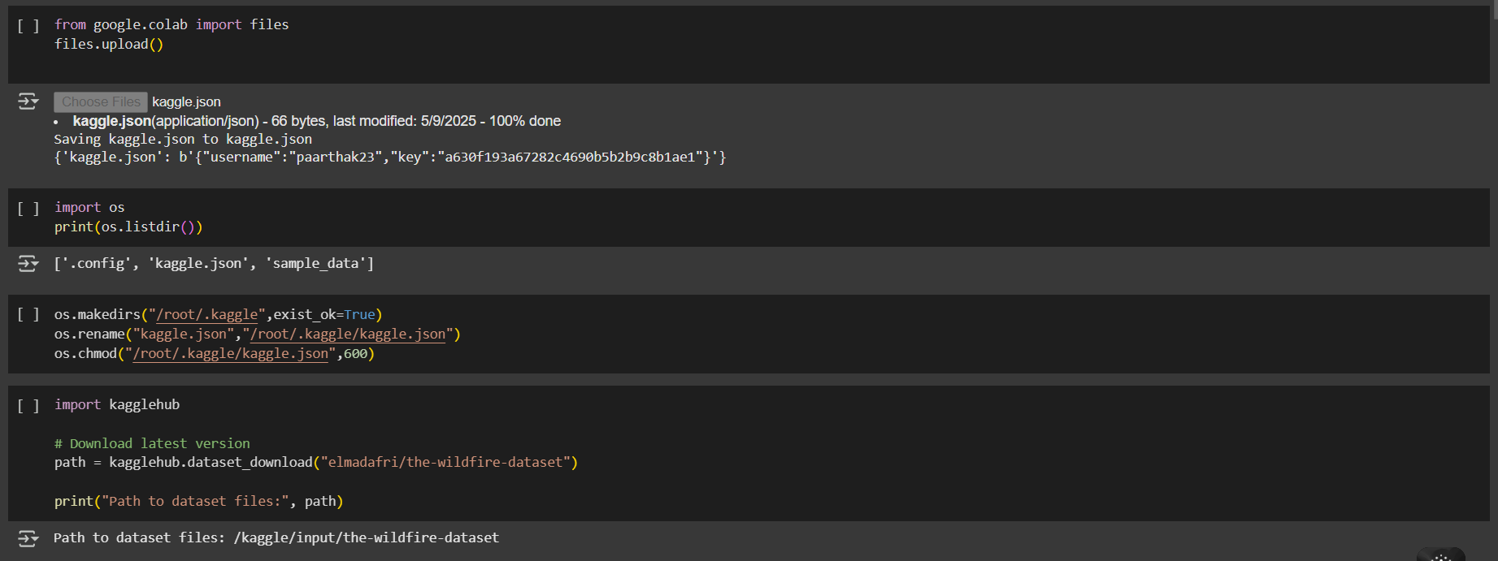
Screenshot of Output:
Importing Json File & Dataset From kaggle

Slide 9
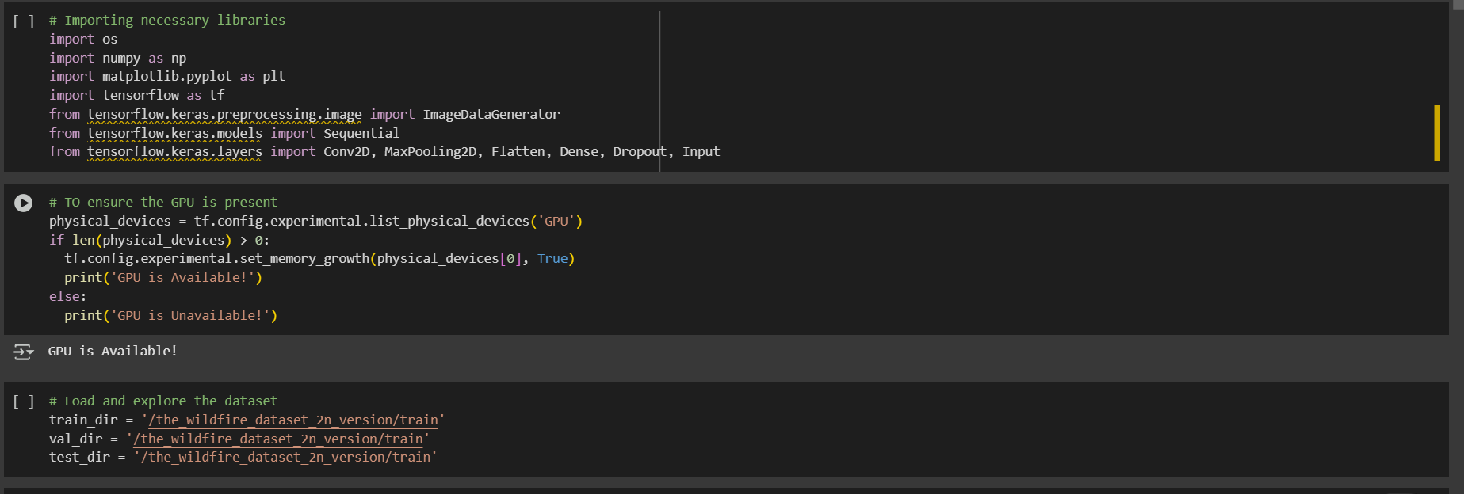
Screenshot of Output:
Importing Tools & Setting up storage

Slide 10
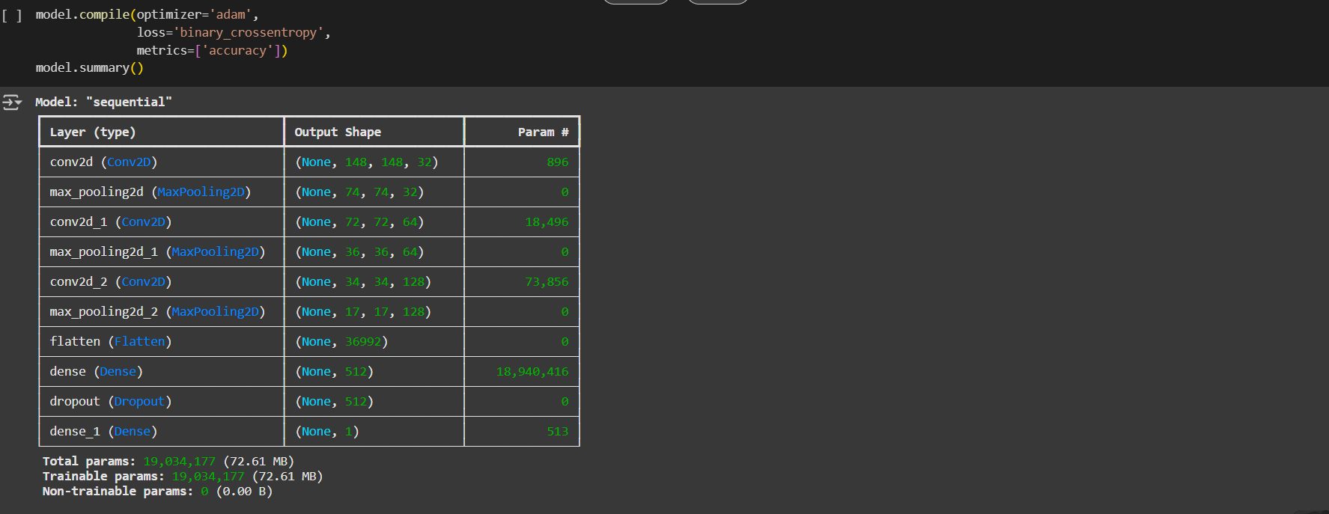
Screenshot of Output:

Slide 11
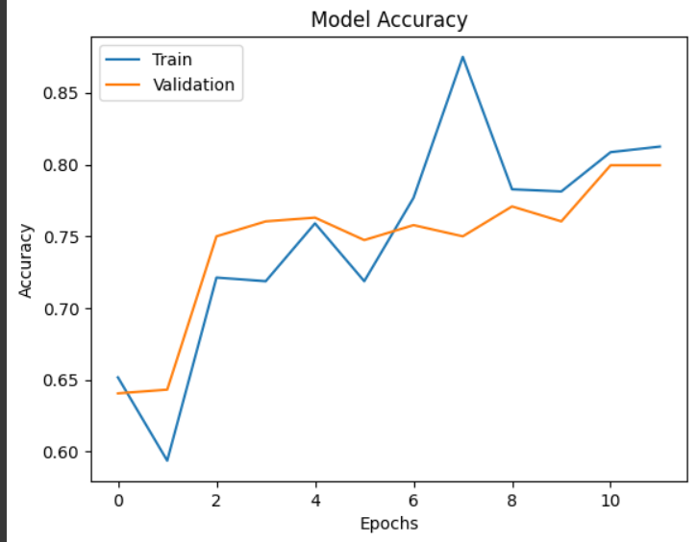
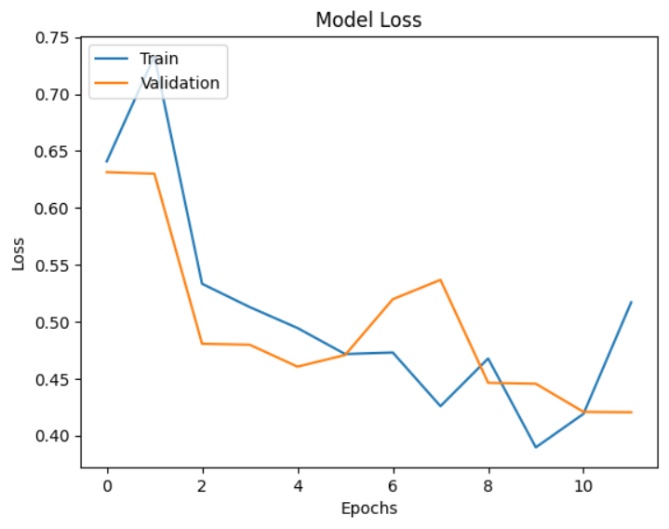
Screenshot of Output:
Model accuracy & Model Loss

Slide 12
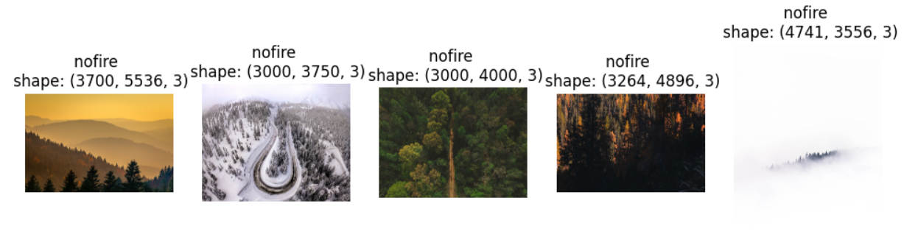
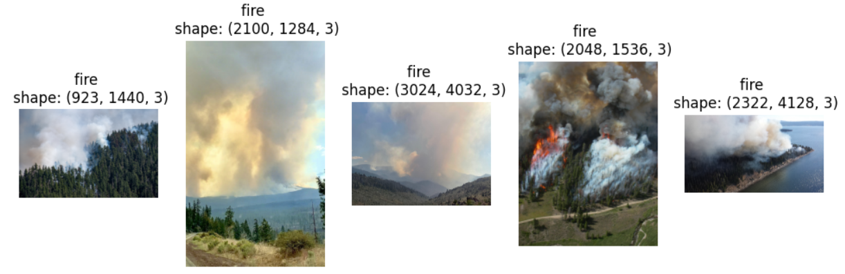
Screenshot of Output:
Trained Data set for Fire & No-Fire

Slide 13
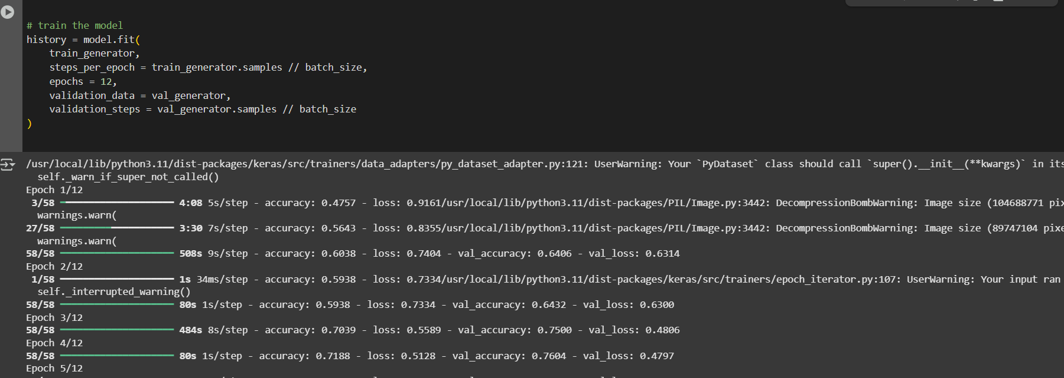
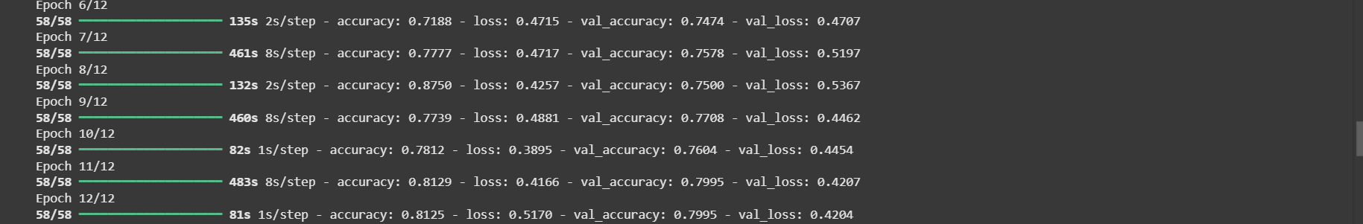
Screenshot of Output:
Training test Data Epoch (Accuracy=81%)

Slide 14
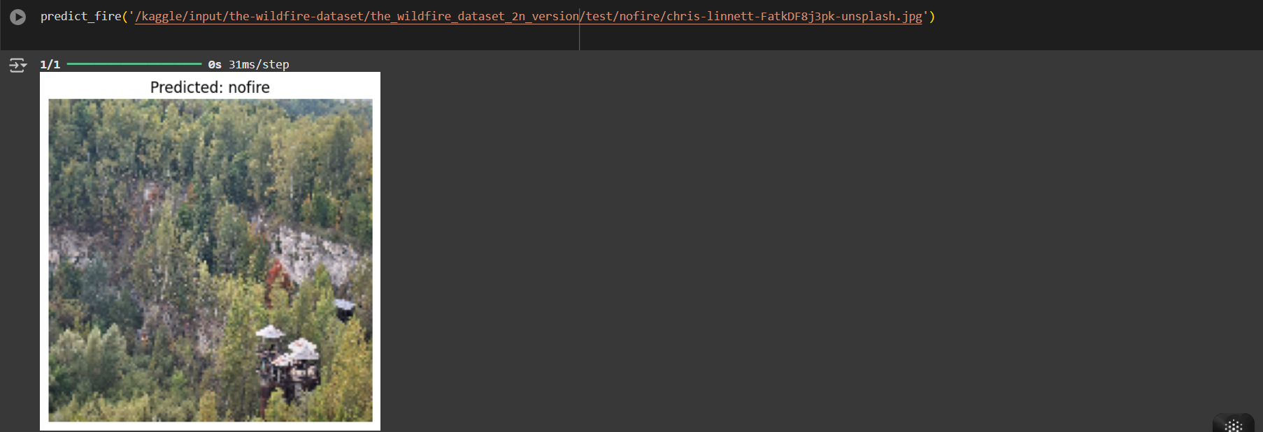
Screenshot of Output:
Final prediction of Classes,images Fire & No-Fire

Slide 15
Conclusion:
I took the forest fire detection dataset from Kaggle and implemented the model on Google Colab, utilizing its free and accessible computing resources. The model was trained to classify images into two classes: fire and no fire. After running 12 epochs, the model achieved a test set accuracy of around 81%, demonstrating its effectiveness in detecting forest fires from visual data. This project highlights the importance of using deep learning techniques to support early detection of forest fires, which can help minimize environmental damage and improve response times for firefighting efforts. For future improvements, the model can be enhanced by incorporating real-time video analysis from drones or surveillance cameras deployed in forest areas. Additionally, expanding the dataset to cover different types of fire scenarios, weather conditions, and forest terrains can improve model robustness. Integrating the system with IoT devices and alert mechanisms would also enable faster and more automated forest fire monitoring, helping to protect natural resources and communities.

